Slide 1



Slide 2

BUSINESS ANALYTICS Introduction to Business Analytics and Core Business Functions
BUSINESS ANALYSIS ETHICS

Slide 3
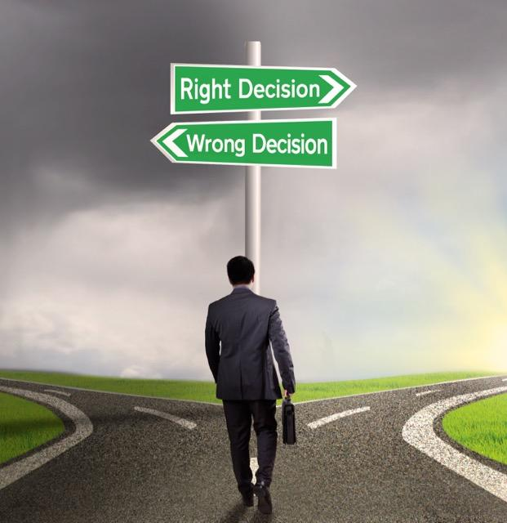
LEARNING OBJECTIVES – WEEK 14
By the end of today you should be able to:
Understand ethical responsibilities of a Business Analyst
Handle sensitive data and confidentiality
Deal with stakeholder pressure ethically
Identify ethical dilemmas in real projects
Make responsible and professional decisions
A good Business Analyst solves problems. A great Business Analyst solves them ethically.

Slide 4
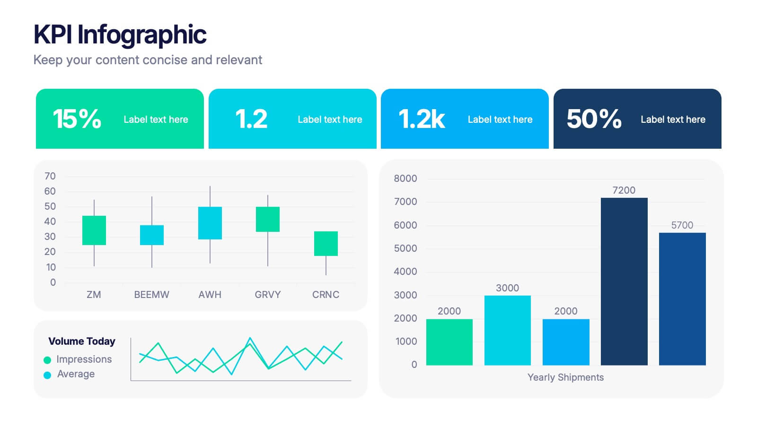
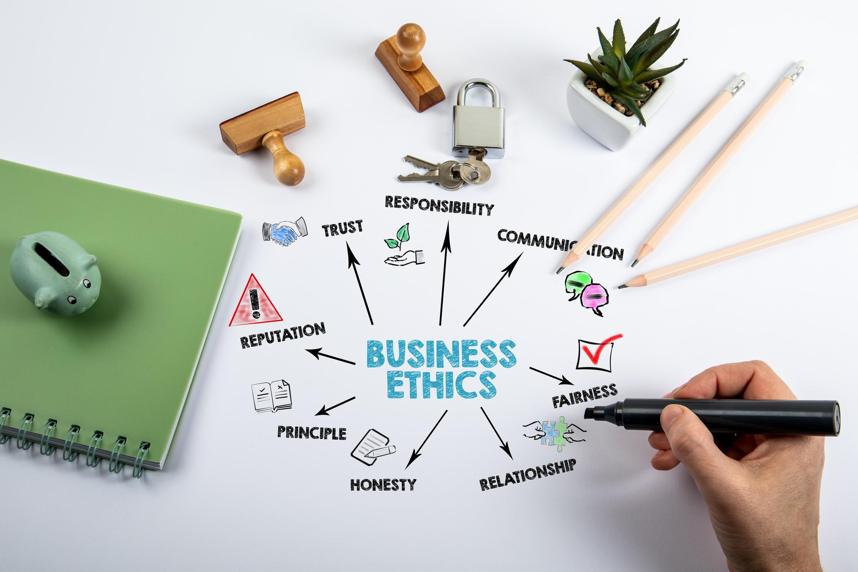
WHY ETHICS MATTERS IN BUSINESS ANALYSIS
BAs sit at the center of:
✔ Business decisions ✔ Data access ✔ Stakeholder communication ✔ System design
👉 This gives power and responsibility
Real Risk
Without ethics:
❌ Wrong decisions ❌ Data misuse ❌ Stakeholder bias ❌ Loss of trust
Core Insight
“Trust is the biggest asset of a Business Analyst.”

Slide 5

Key Ethical Principles for BAs
1️⃣ Integrity
Be honest and transparent.
✔ Don’t manipulate data ✔ Don’t hide problems
2️⃣ Confidentiality
Protect sensitive information.
✔ Customer data ✔ Financial data ✔ Company strategy
🇵🇰 Example
Client asks:
“Show only positive results.”
BA response:
Present full data with explanation.
🌎 Example
Netflix user data cannot be shared externally.
⚠️ Rule:
If unsure → don’t share.

Slide 6
Key Ethical Principles for BAs
3️⃣ Objectivity
Avoid bias.
✔ Don’t favor one stakeholder ✔ Base decisions on facts
4️⃣ Accountability
Own your work.
✔ Take responsibility for errors ✔ Communicate risks early
Example
CEO wants feature A. Data shows feature B is better.
BA must present facts.
Example
If requirement was unclear → don’t blame dev → fix it.
5️⃣ Professional Behavior
✔ Respect stakeholders ✔ Communicate professionally ✔ Maintain boundaries

Slide 7
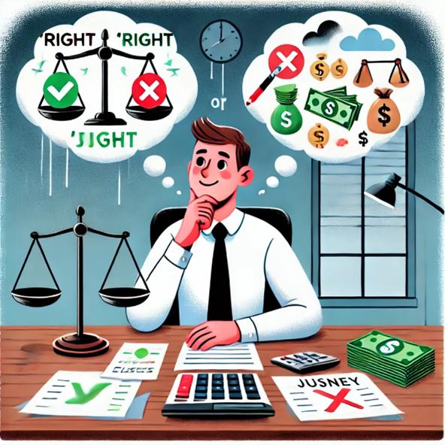
Common Ethical Dilemmas
Scenario 1: Data Manipulation
Manager says:
“Adjust numbers to make report look better.”
👉 Ethical BA:
Refuses manipulation, explains impact.
Scenario 2: Hiding Issues
Team finds major bug before release.
Manager says:
“Don’t tell client.”
👉 Ethical BA:
Escalates risk.
Scenario 3: Stakeholder Pressure
Senior executive pushes unrealistic feature.
👉 Ethical BA:
Explains feasibility and impact.
Scenario 4: Confidential Information
You switch jobs.
New company asks:
“Share previous company’s data.”
👉 Ethical BA:
Refuses.

Slide 8
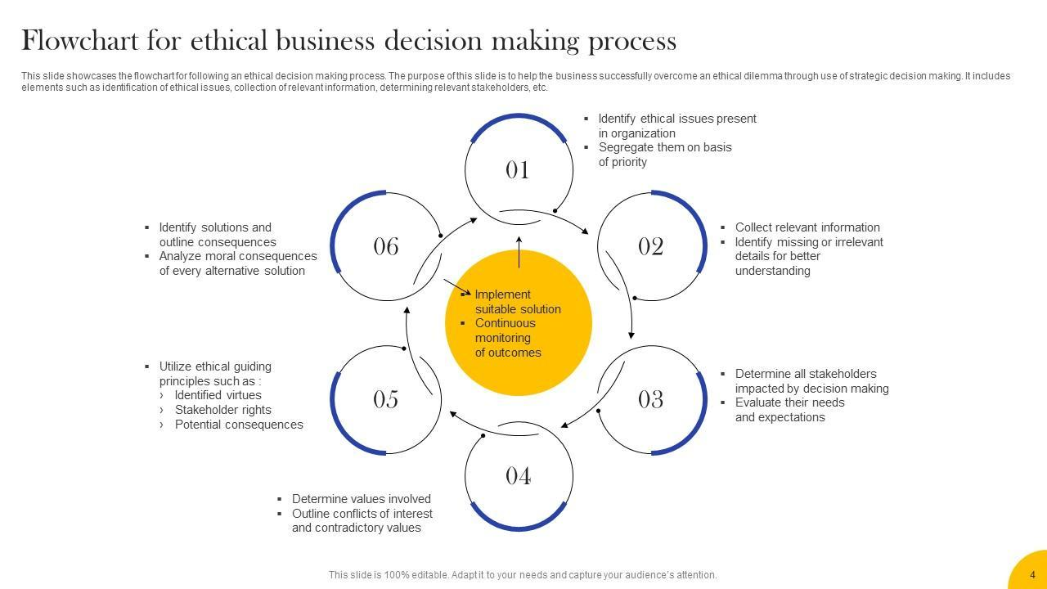
Ethical Decision-Making Framework
Step 1:
Identify the issue
Step 2:
Who is affected?
Step 3:
What are options?
Step 4:
What is the ethical choice?
Step 5:
Communicate professionally

Slide 9
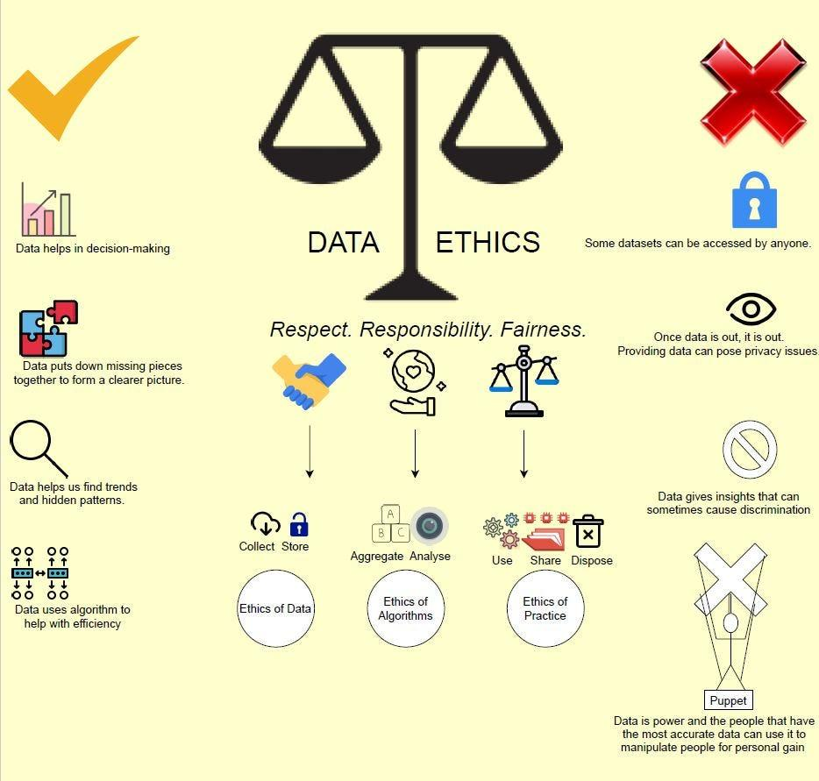
Ethics in Data & Analytics
Very important for modern BA.
Risks
❌ Misleading dashboards ❌ Wrong KPIs ❌ Biased analysis
Example
Showing average delivery time only (hiding peak delays)
Ethical BA:
Shows full picture.

Slide 10
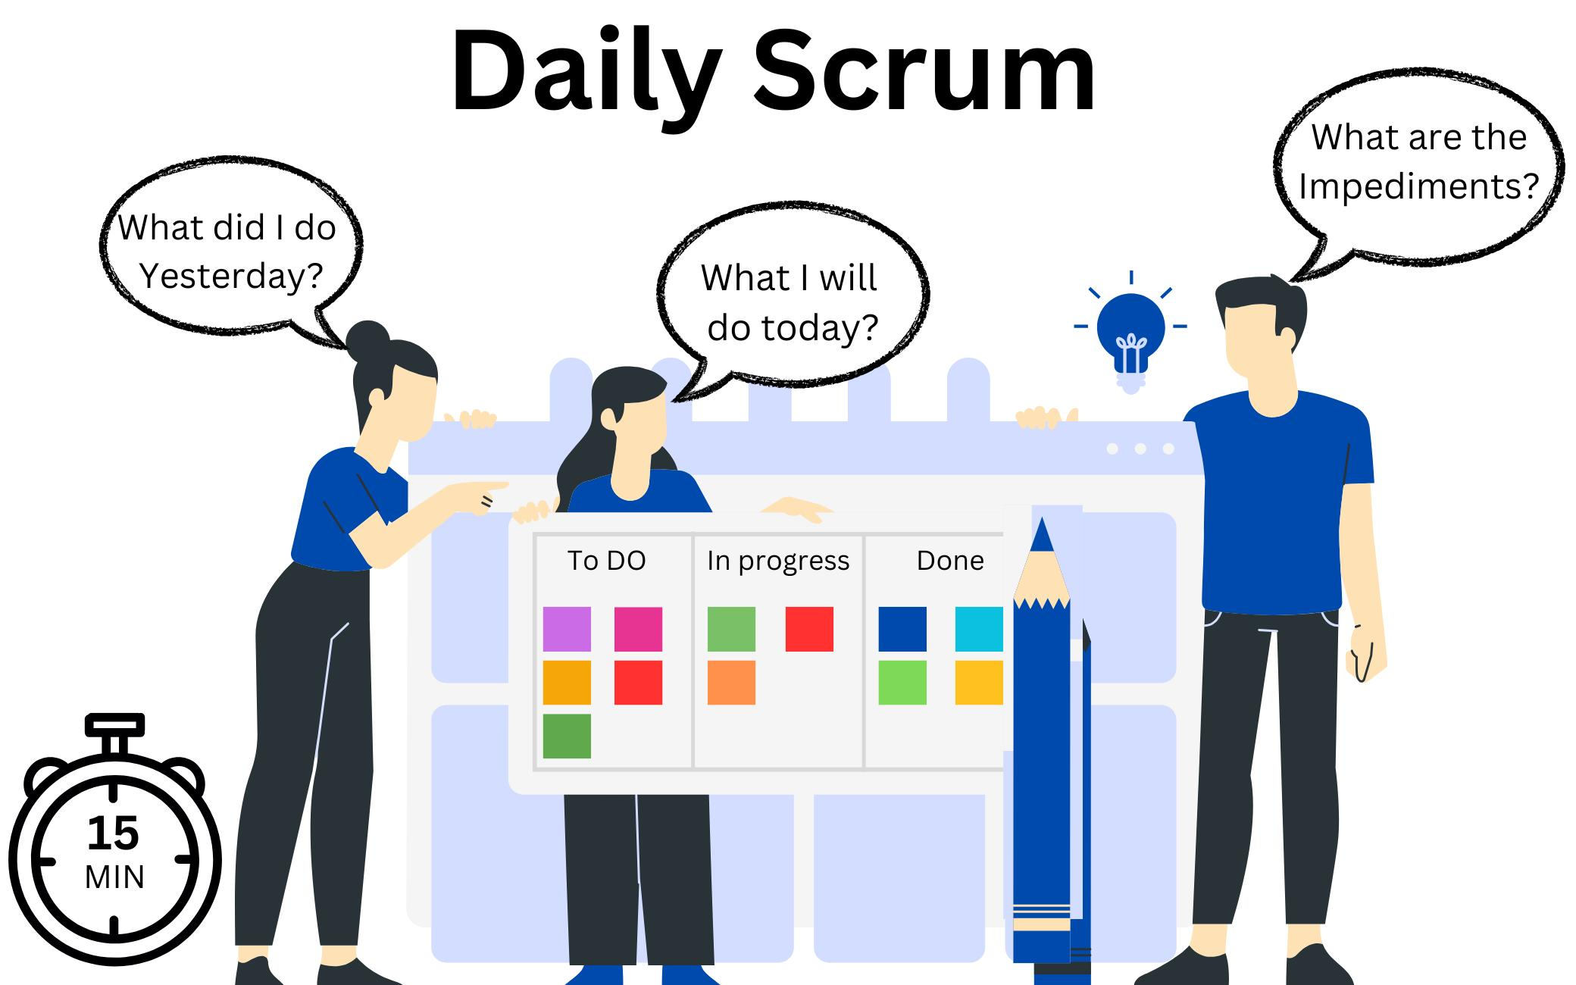
Ethics in Agile & Teams
In Agile:
✔ Be transparent in standups ✔ Don’t hide blockers ✔ Give honest updates ✔ Respect team contributions
Example
Don’t say:
“Everything is fine”
When sprint is failing.

Slide 11
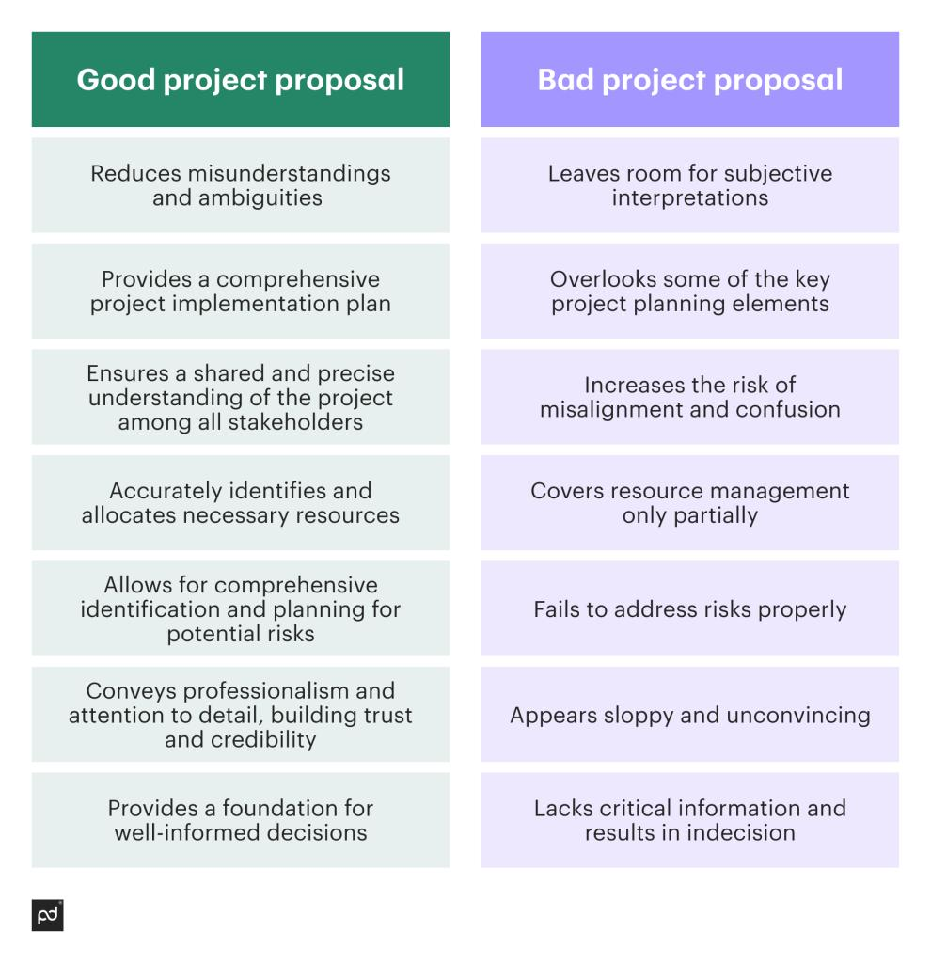
Ethics in Documentation
✔ Write clear requirements ✔ Avoid ambiguity ✔ Don’t copy blindly ✔ Ensure traceability
Student Warning
Copy-paste documentation
= unethical practice

Slide 12
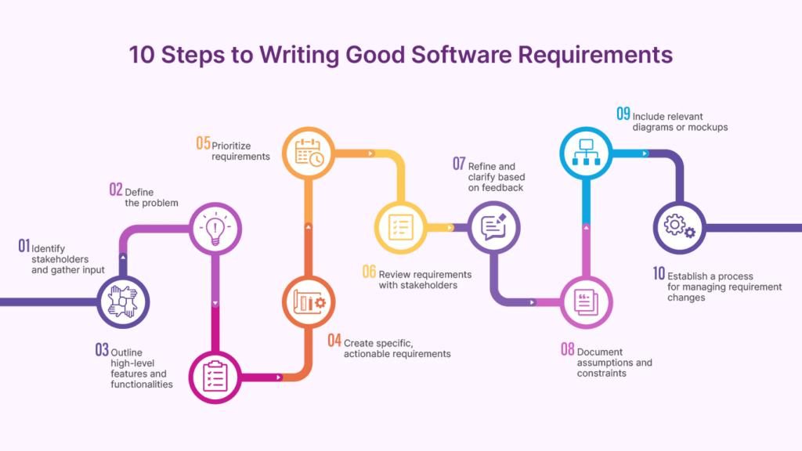
Ethics in Documentation

Slide 13
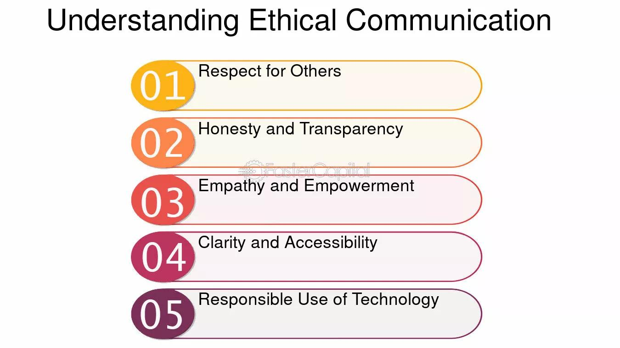
Ethics in Communication
✔ Don’t mislead ✔ Don’t overpromise ✔ Don’t under-communicate
Example
Wrong:
“Feature will be done tomorrow”
Right:
“Estimated completion is 2 days based on current progress.”

Slide 14
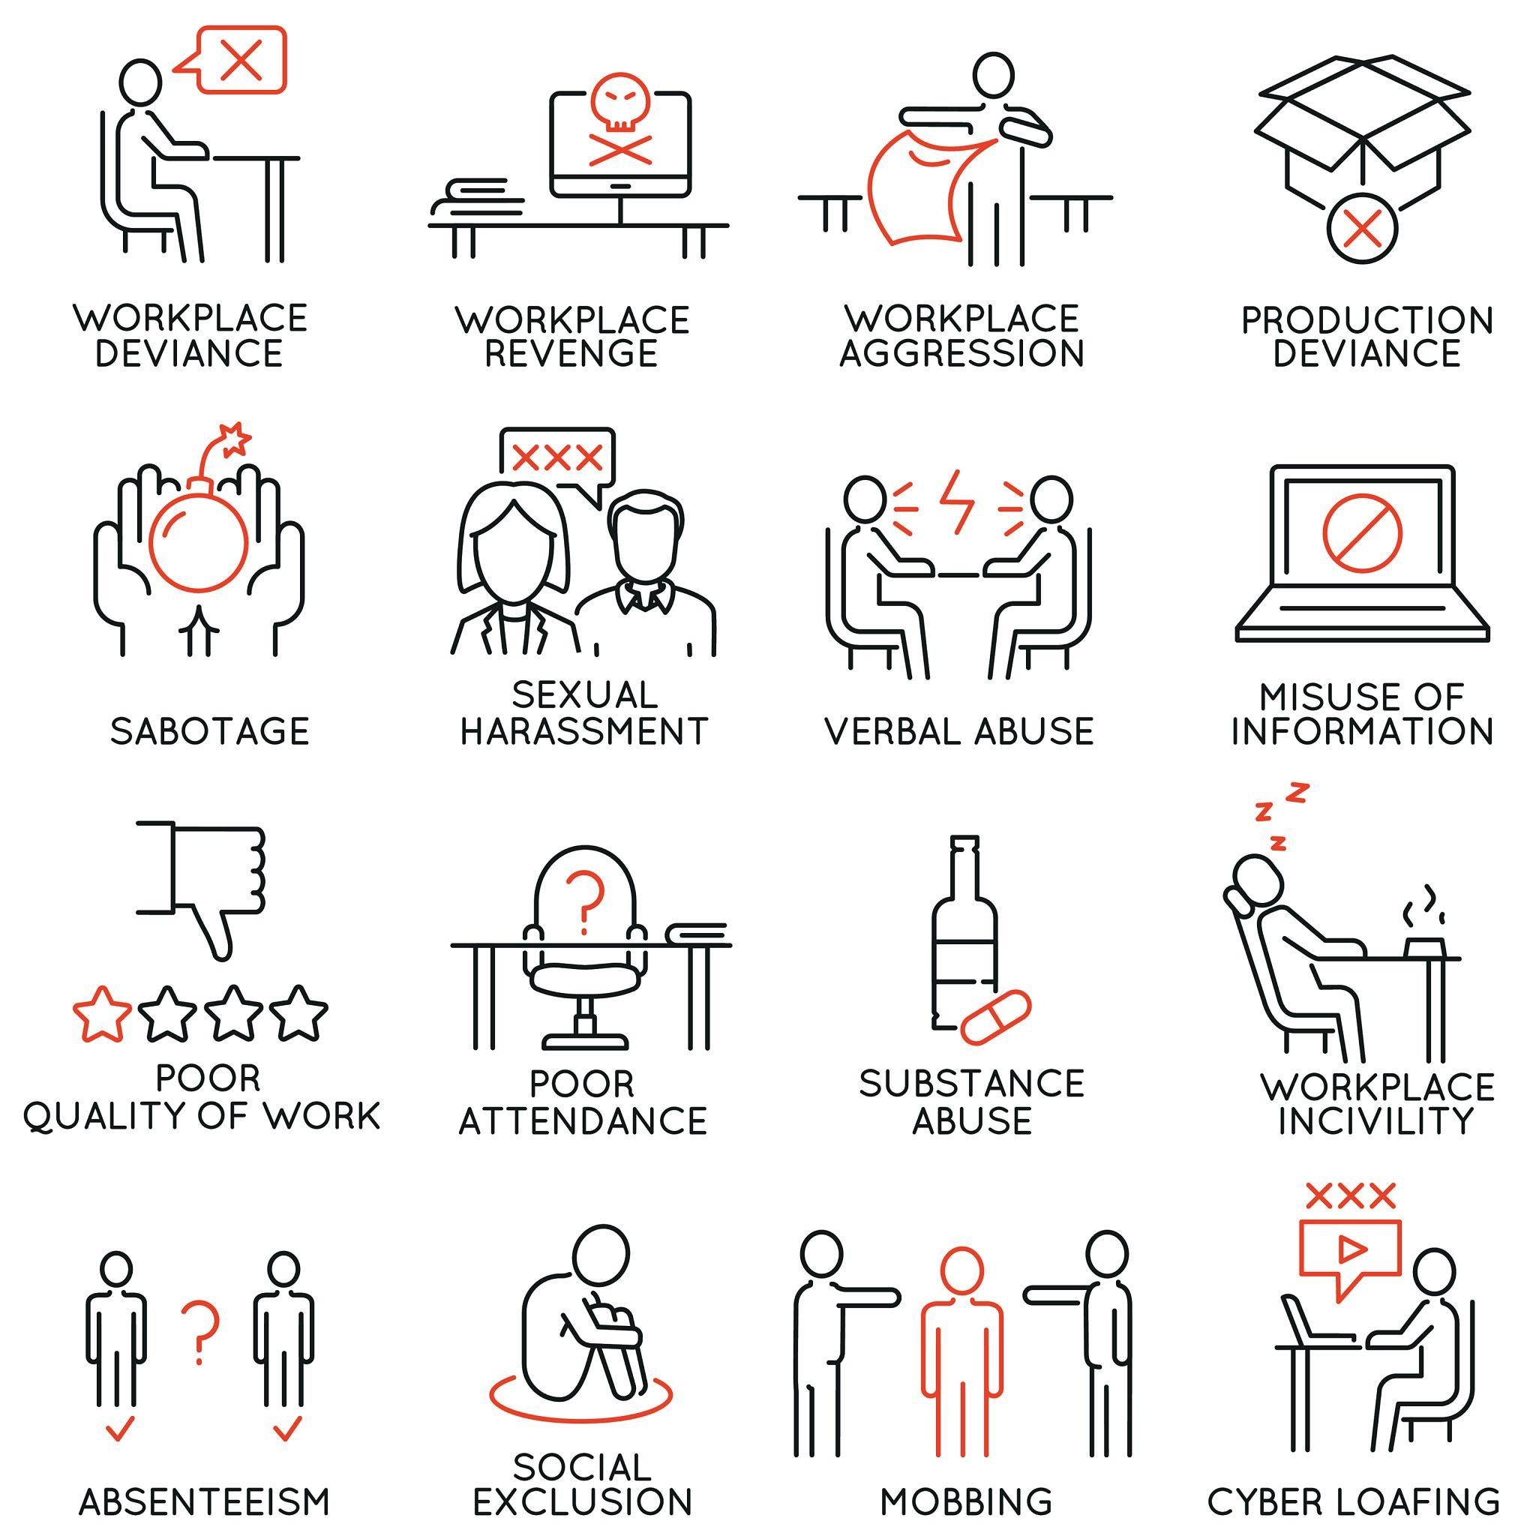
Common Ethical Mistakes by New BAs
❌ Saying yes to everything ❌ Hiding risks ❌ Not asking questions ❌ Sharing sensitive data ❌ Copying work

Slide 15
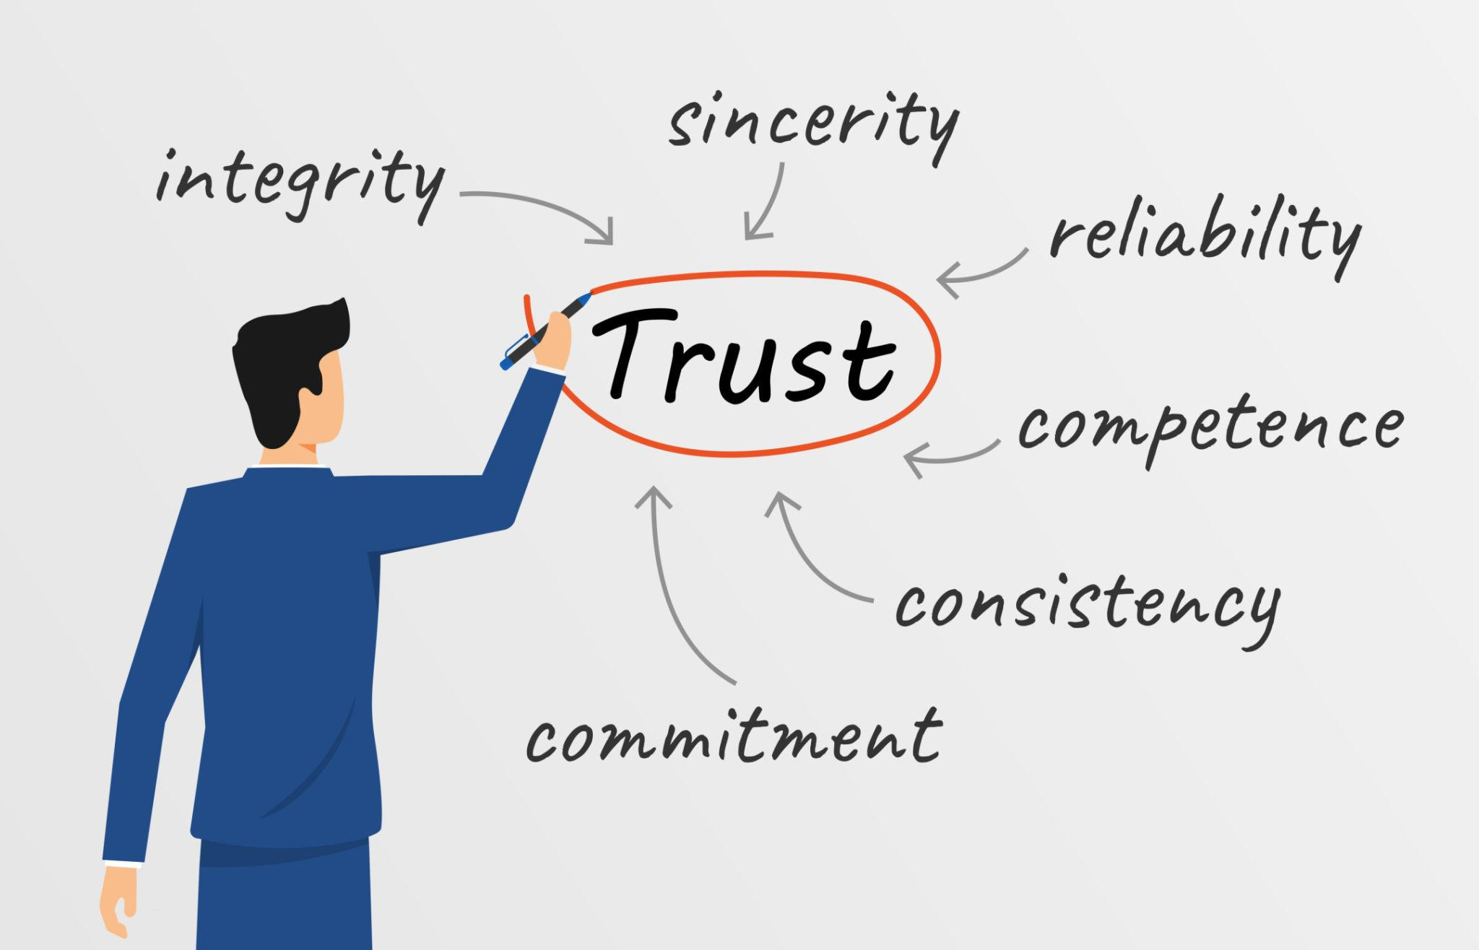
Role of Ethics in Career Growth
Companies trust ethical professionals.
Benefits
✔ Strong reputation ✔ Leadership opportunities ✔ Long-term success
Risk of unethical behavior
❌ Job loss ❌ Reputation damage ❌ Legal issues

Slide 16
KEY TAKEAWAYS (END OF LECTURE)
✔ Ethics is not optional ✔ Data must be handled responsibly ✔ Transparency builds trust ✔ BA must balance business & ethics ✔ Your decisions impact real people
“The hardest decisions in projects are not technical — they are ethical.”
“Short-term shortcuts create long-term damage.”
“Trust once lost is very hard to regain.”
“Strong BAs are trusted advisors, not just analysts.”

Slide 17
Question 👉 “What would you do if asked to act unethically?

